Slide 1
MULTIMEDIA

Slide 2
HMTL MULTIMEDIA
Audio tag
Video tag
Embed
iframe / Youtube

Slide 3
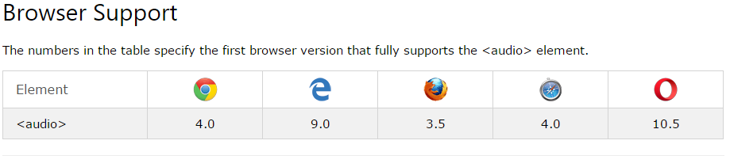
Audio on web
The HTML5 <audio> element specifies a standard way to embed audio in a web page. Similar to the img tag, its syntax is :
<audio controls src="media/birds.mp3"></audio>

Slide 4
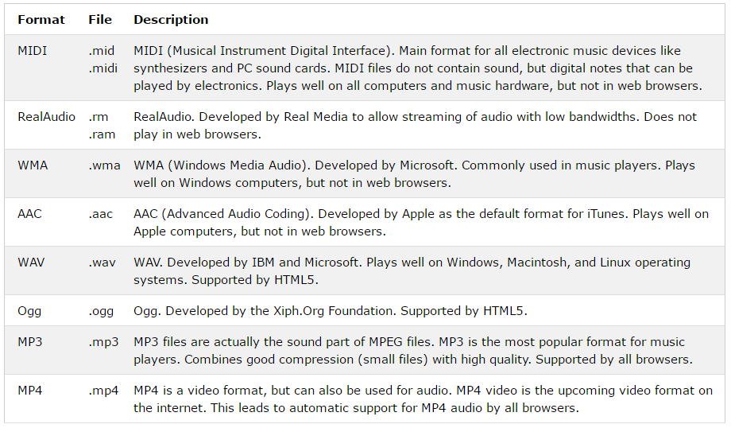
MULTIMEDIA FILE FORMATS

Slide 5
<audio controls>
<source src="myAudio.ogg" type="audio/ogg" />
<source src="myAudio.wav" type="audio/wav" />
Your browser does not support the audio tag
</audio>
To download some free short sound
https://pixabay.com/sound-effects/search/short/
https://www.freepik.com/videos/short
The browser will attempt to play the ogg version and then play the mp3 version if it can not play the ogg format
But if the browser can not play any of the audio files, it will display the message on your browser
The text between the <audio> and </audio> tags will only be displayed in browsers that do not support the <audio> element

Slide 6
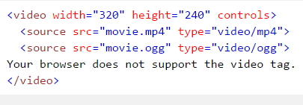
THE HTML <VIDEO> ELEMENT
To show a video in HTML, use the <video> element:
  Note that the video files must be existing at the location specified in the src
The nested source tag allows you state various file alternatives (different extensions)
The browser displays the text ‘Your browser does not support the video tag If it cant play any of the file (format) specified

Slide 7
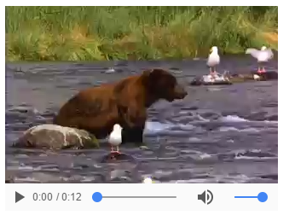
VIDEO TAG

Slide 8
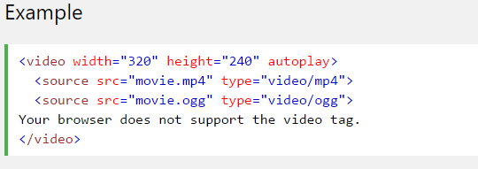
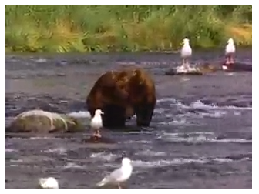
Using Autoplay
To start a video automatically use the autoplay attribute: (this often works when the attribute muted is present)

Slide 9
HTML LINKS (Anchor tags)
Navigating around your website…

Slide 10
HTML LINKS
Links are found in nearly all web pages. Links allow users to click their way from page to page.
You can click on a link and jump to another document.
The HTML <a> tag defines a hyperlink. It has the following syntax:
<a href="url">link text</a>
The most important attribute of the <a> element is the href attribute, which indicates the link's destination.
The link text is the part that will be visible to the reader.
Clicking on the link text, will send the reader to the specified URL address.

Slide 11
Link Colors:
By default, a link will appear in all browsers :
    An unvisited link is underlined and blue
    A visited link is underlined and purple
    An active link is underlined and red
  Example: On the Home page, we can create a link to the about us page by specifying as below:
    <a href=“aboutpage.html">About Us</a>
On the About page, we can create a link to the Home page by specifying as below:
<a href=“homepage.html">Home</a>

Slide 12
LINKS:
We can also add title attribute to our link to enable our users to know where the link is going to.
<a href="https://www.facebook.com" title="Go to Facebook">Visit our Facebook Page</a>
We can also use button to implement the linking.
<button onclick="document.location='default.asp’”>Facebook</button>

Slide 13
LINKING To Folders above and below
So far we have linked 2 pages together when they are both within the same folder. This is SCENARIO 1
There are other possibilities of a file linking to another file (SCENARIO 2); If a file wants to link to:
Another file A that is located in a foldername beside it: in this case, file A is below me. We write:
    <a href=“foldername/filename.html”>Link to File A Below Me</a>
  Another File A that is in a folder above me: in this case, I need to get out of where I am in order to see File A, we write:
    <a href=“../fileA.html”>Link to File a Above Me</a>
    To go out of where you are: use ../
    To go into a folder use: folder/

Slide 14
Global and Local link (Absolute vs. Relative URLs)
An absolute URL is one that takes the full web address in the href attribute. It uses the World Wide Web ("https://www" )
NOTE: It is also good that external links are opened in a new tab
A local link (a link to a page within the same website) is specified with a relative URL (without the "https://www" part):
Example
    <h2>Absolute URLs</h2>
    <p><a href="https://www.facebook/">Facebook</a></p>
    <p><a href="https://www.google.com/">Google</a></p>
    <h2>Relative URLs</h2>
    <p><a href="index.html">Home</a></p>
    <p><a href="aboutpage.html">About Us</a></p>

Slide 15
HTML Links - The target Attribute
NOTE: By default, the linked page will be displayed in the current browser window. To change this, you must specify another target for the link.
The target attribute specifies where to open the linked document.
The target attribute can have one of the following values:
_self - Default. Opens the document in the same window/tab as it was clicked
_blank - Opens the document in a new window or tab
_parent - Opens the document in the parent frame
_top - Opens the document in the full body of the window

Slide 16
Example:
<a href="https://facebook.com/" target="_blank">Visit Facebook!</a>
Question: Where do you think this link will take us to? Same webpage or a different one?

Slide 17
Link and Image
We can also use a link on our images such that when the image is clicked, it takes the user to another page
The simple syntax for this:
<a href="">
<img src="" alt="" style="">
</a>

Slide 18
Link and Email Address
Use mailto: or tel: inside the href attribute to create a link that opens the user's email program that allows them send a new email and to allow them open phone directly to the number in the tel: href.
<a href="mailto:someone@example.com">Send email</a>
<a href="tel:027426474"> 027426474 </a>
Try it You
Link and Titles
The title attribute specifies extra information about an element. The information is most often shown as a tooltip text when the mouse moves over the element.
Example
<a href="https://www.facebook.com" title="Go to Facebook">Visit Facebook</a>

Slide 19
ASSIGNMENT
Create a 3-page school website (Home, About-Us, Contact-Us), make all pages linked to each other such that the user can click to navigate all pages.
Home page should have a text, image gallery, list items and any other information related to school.
The About Us page should have some texts telling us about the website, an image, a youtube video,
The Contact Us page should have a contact form that collects user Name, surname, email, phone number, date f birth, state, gender, message box, terms and condition box, and a submit button with green background.
NOTE: You are to use all you’ve been taught so far.

